Slide 1
Why some companies in Canada are struggling to find quality SDN developer Candidates?
Group – 6
-Aditi Pandya
-Anjali Prajapati
-Dhara Barot
-Venkata Narasimha Vedavyas Muppavarapu

Slide 2
WHY SDN? -Centralized control -Programmability
Difference between SDN and traditional networking:
-Control plane separation -Dynamic traffic routing
Notes:
Software-defined networks (SDN) offer several advantages over traditional networking technologies:
Centralized control: SDN allows for a centralized controller that can manage and configure the entire network, making it easier to implement changes and improve network efficiency.
Programmability: SDN allows for network programmability, making it easier to automate and customize network functions and policies(Network policies refer to a set of rules that determine how traffic is handled within a network. Programmability allows for the customization and automation of network policies, making it easier to implement and enforce rules that align with business objectives.).
Differences between SDN and traditional networking:
Control plane separation: SDN separates the control plane(The control plane is responsible for managing and configuring the data plane by making decisions on how to handle network traffic.) from the data plane(The data plane, also known as the forwarding plane, is responsible for the actual forwarding of network traffic within the network.), allowing for greater flexibility and programmability, while traditional networking combines both.
Dynamic traffic routing: SDN allows for dynamic traffic routing based on real-time network conditions, while traditional networking typically uses static routing protocols.

Slide 3
Problem Statement assessment
Reasons:
Skills gap
Competition for talent
Lack of awareness
Reliance on certifications
Limited education options
Rapidly evolving technology
Notes:
Skills gap: SDN requires a combination of networking, programming, and software-defined skills. Many traditional networking professionals may not have these skills, while many software developers may not have networking expertise. Finding candidates with the right mix of skills can be challenging.
Competition for talent: SDN is a high-demand skillset, and companies across various industries are vying for SDN talent. This competition for talent can drive up salaries and make it more challenging for smaller companies to attract top talent.
Lack of awareness: SDN is a relatively new technology, and not all developers may be familiar with it or have experience working with it. This could limit the pool of available candidates for SDN roles.
Reliance on certifications: Some companies may rely too heavily on certifications as a way to filter candidates, which could exclude otherwise qualified candidates who do not have specific SDN certifications.
Limited education options: While there are some SDN-focused courses and programs, they may not be widely available, which can limit the number of candidates who have formal education in SDN.
Rapidly evolving technology: SDN is still evolving, and new technologies and standards are being introduced regularly. This can make it challenging for candidates to keep up with the latest developments and for companies to find candidates who are up-to-date with the latest SDN trends and practices.

Slide 4


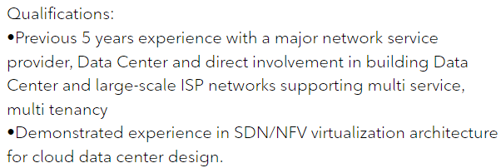
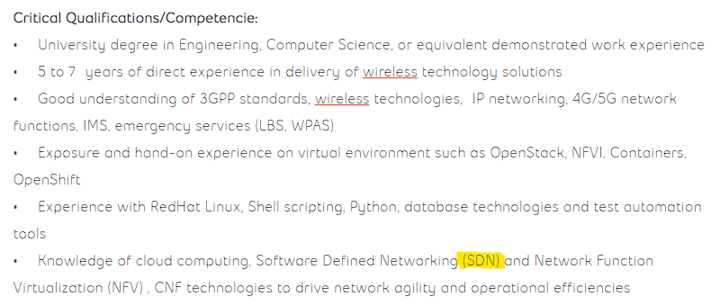

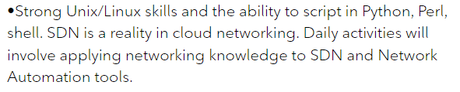
Rogers Bell
https://jobs.rogers.com/job/Toronto-IP-Network-Engineer-ON/996343000/
https://jobs.bell.ca/ca/en/job/BECACA402151EXTERNALENCA/Senior-Advisor-Core-Engineering
Notes:
Rogers:
https://jobs.rogers.com/job/Toronto-IP-Network-Engineer-ON/996343000/
Bell:
https://jobs.bell.ca/ca/en/job/BECACA402151EXTERNALENCA/Senior-Advisor-Core-Engineering

Slide 5
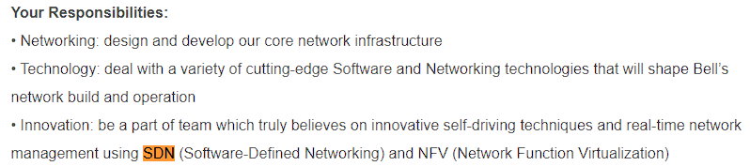
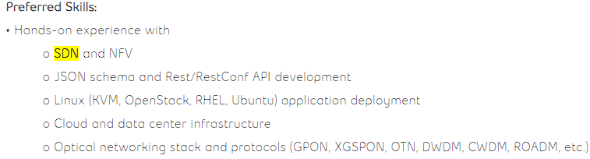
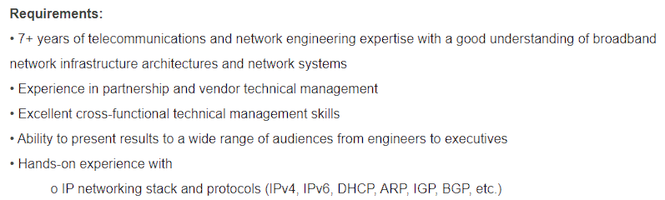
Bell - Senior Network Infrastructure Architect - IP
https://jobs.bell.ca/ca/en/job/BECACA407996EXTERNALENCA/Senior-Network-Infrastructure-Architect-IP
Notes:
Bell:
SDN:
https://jobs.bell.ca/ca/en/job/BECACA407996EXTERNALENCA/Senior-Network-Infrastructure-Architect-IP

Slide 6
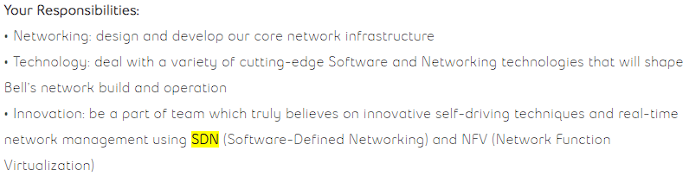
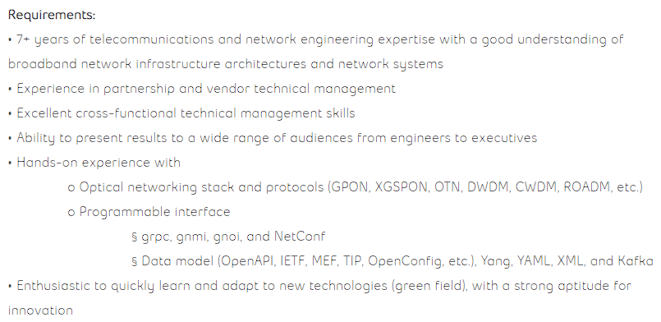
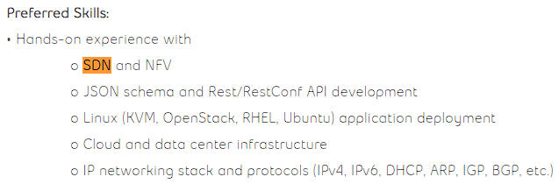
Bell - Senior Network Infrastructure Architect - Optical
https://jobs.bell.ca/ca/en/job/BECACA407997EXTERNALENCA/Senior-Network-Infrastructure-Architect-Optical
Notes:
Bell:
SDN:
https://jobs.bell.ca/ca/en/job/BECACA407997EXTERNALENCA/Senior-Network-Infrastructure-Architect-Optical
Non SDN:
https://jobs.bell.ca/ca/en/job/BECACA408693EXTERNALENCA/Specialist-Core-Engineering

Slide 7


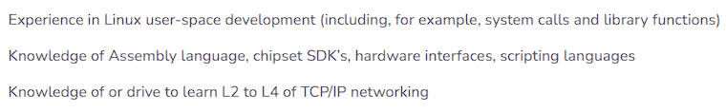
NOVIFLOW - Software Developers (all levels) – Software Defined Networking – Forwarding Plane Team
https://noviflow.com/forwarding-plane-team/
Notes:
NoviFlow:
SDN:
https://noviflow.com/forwarding-plane-team/

Slide 8


NOVIFLOW - Software Developers (all levels) – Software Defined Networking – Application Team
https://noviflow.com/application-team-job-description/
Notes:
NoviFlow:
SDN:
https://noviflow.com/application-team-job-description/
Non SDN:
https://noviflow.com/technical-customer-support-representative/
Python Programmer

Slide 9
CONCLUSION: -More demand than supply Primary reason: Lack of skills, awareness of sdn technology for a developer.

Slide 10
Thankyou.

